Slide 1
V6 PLM Enterprise Integration Strategy How Customers can connect V6 with their existing Enterprise systems ?
V6 R2009x

Slide 2


V6 PLM Openness definition
What makes the Openness of the V6 platform?
V6 SOA (Service Oriented Architecture)
V6 Compliance to IT Standards
V6 Support of Open Standard & Industry Formats
V6 Multi-Cad integration
V6 Extensibility & Customization model
V6 PLM Integrated Development Environment (IDE)
V6 Integration with External Systems
Today’s presentation is focusing on this specific topic
Notes:
IDE IntegratedDevelopmentEnvironment

Slide 3
Dassault Systemes’ PLM2.0 – V6 platform
V6 delivers a comprehensive set of PLM applications
Portfolio Planning
Concept Development
Design
Production
& Testing
Maintenance
& Support
Retirement & Disposal

Slide 4






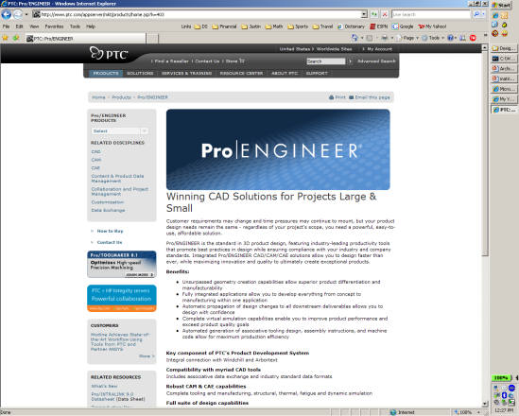
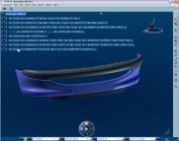
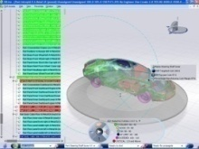
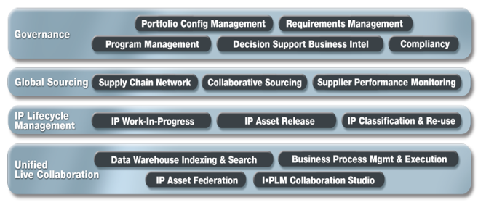
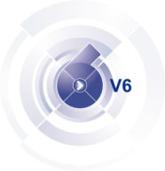

Integrating V6 with Heterogeneous Systems
To support existing processes and Collaborate across disciplines
Desktop Applications Integration
Check-IN my Design as a New Revision
Electronic
IP Federation
ECAD
1
ECAD
n
Designer
Mechanical
Give me the Program instant dashboard
MCAD
1
MCAD
n
Simulation
CAE
1
CAE
n
Product Manager
Software
SW
1
SW
n
Release the Product
Synchronize the EBOM
xPDM Orchestration
ERP
Enterprise PDM

Slide 5
Agenda
3
V6 PLM Integration Strategy
1
1.1
Desktop Applications Integration
1.2
IP Federation
1.3
xPDM orchestration

Slide 6
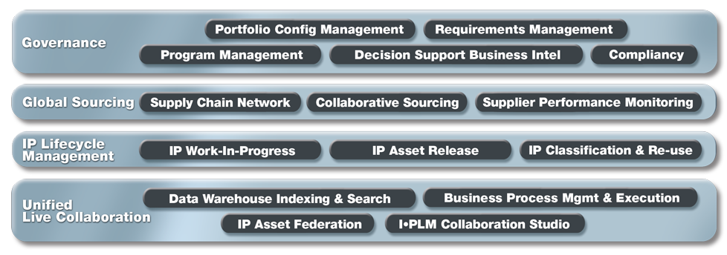
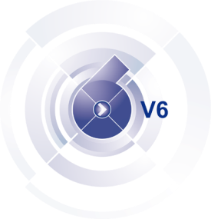
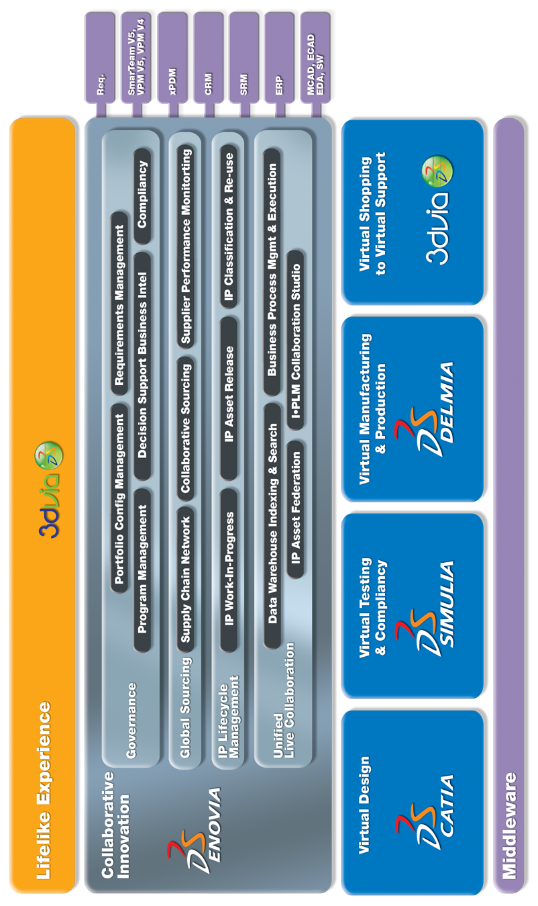
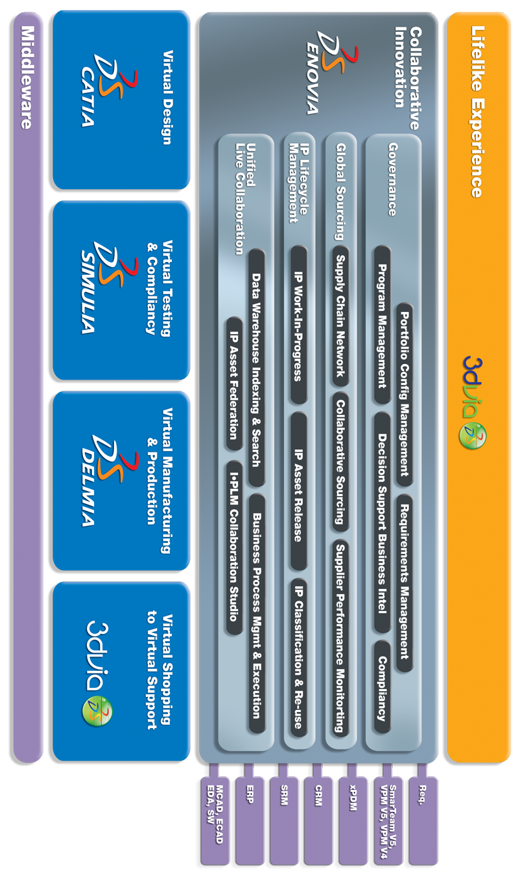
Integrating V6 with External Systems
Leveraging V6 Unified Live Collaboration backbone to connect V6 with xPDM/ERP/CRM/etc systems
Desktop
Enterprise
Use Cases
Authoring Application Integration
Heterogeneous Collaborative Design & Engineering
IP Digital Asset Management
Desktop Application
xPDM Orchestration
IP Federation
Connectors

Slide 7
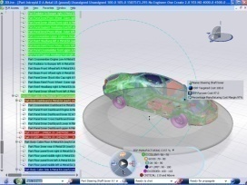
Integrating V6 with External Systems
IP Federation: Master Data focus
Enables access and consume in V6 information stored in various enterprise systems (ERP, PDM, etc.) as if these data were in V6.
Single logical database, “single version of the truth”
Real-time
Without replicating data in V6
Without modifying data in target system
xPDM Orchestration: Process Focus
Set up a formal process between different PLM systems to allow information exchange and synchronization
Bi-directional, asynchronous exchange
Partial data are replicated in systems
Replicated data can be alternatively authored in both systems with enforced control
Fully automatic, no user or admin required in replication/synchronization
no more issue of reconciliation
V6
xxx
xxx
xxx
Real-time
V6
xxx
Asynchronous

Slide 8
Agenda
3
V6 PLM Integration Strategy
1
1.1
Desktop Applications Integration
1.2
IP Federation
1.3
xPDM orchestration

Slide 9
Integrating V6 with External Systems Desktop Applications
Desktop
Authoring Application Integration
Enterprise
Desktop
Use Cases
Authoring Application Integration
Heterogeneous Collaborative Design & Engineering
IP Digital Asset Management
Desktop Application
xPDM Orchestration
IP Federation
Connectors

Slide 10
V6 Integration framework for Desktop Applications
V6 has a single data model that supports any type of integration
Data mgr’s could be replaced with direct integration to ENOVIA that leverage the desktop data in the most cost effective and efficient way
Apply Business Process to merge desktop data with overall product development process (workflow, lifecycle mgmt, EBOM synchronization, etc)
Firmware
Software
Legacy 2D
OFFICE
Applications
Electronic CAD
Mechanical CAD
Integration Framework
HTTP
ENOVIA V6

Slide 11
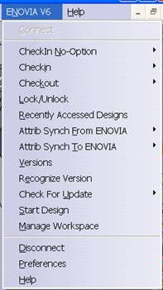
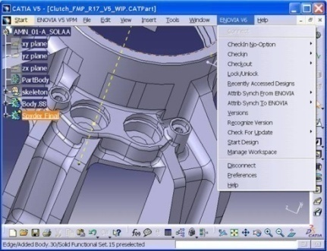
CAD Integration example
Immersive, dedicated integrations to 3rd party authoring or information systems with seamless user experience
As an example CATIA V5 /ENOVIA V6 (CT5) is based upon Desktop Application Integration
CT5 brings the immersive menu delivering CAD mgr functions:
checkIn with/without New Revision
CheckOut
Lock-unLock
Attributes Synchronization
Etc …
Menu is Implementedwith V5 native APIs
Same mechanism for:
HTTP
ENOVIA V6

Slide 12
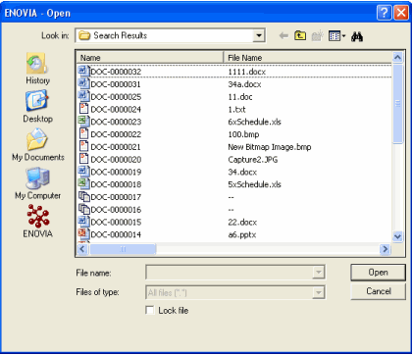
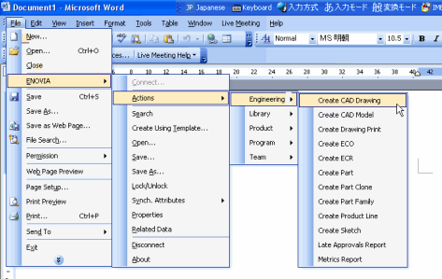
MS Office&Desktop Integration example
Immersive, dedicated integrations to 3rd party authoring or information systems with seamless user experience
ENOVIA Collaboration for MS Office&Desktop Feature
Brings the immersive menu delivering Doc Mgr functions:
Connection to ENOVIA V6
Search
Lock-unLock
Attributes Synchronization
Download Files by Drag and Drop
Notes:
Autre exemple d’integration Point 2 Point : le Produit ENOVIA Collaboration pour Microsoft permettant l’integration des applications MS Office – PowerPoint, Word, Excel, Outlook, Project . Un menu contextuelle ENOVIA permet l’acces aux documents offices gere par ENOVIA V6, une integration avec Windows desktop pour la manipulation des documents via drag & drop

Slide 13
Agenda
3
V6 PLM Integration Strategy
1
1.1
Desktop Applications Integration
1.2
IP Federation
1.3
xPDM orchestration

Slide 14
Integrating V6 with External Systems IP Federation
IP Digital Asset Mgmt
IP Aware Applications
Program Dashboarding
Enterprise Master Data
Decision support
Desktop
Use Cases
Authoring Application Integration
Heterogeneous Collaborative Design & Engineering
Desktop Application
xPDM Orchestration
IP Federation
Connectors

Slide 15

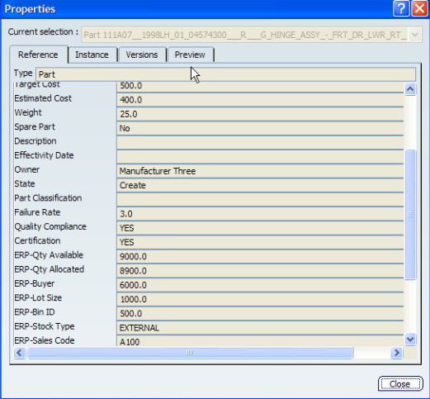
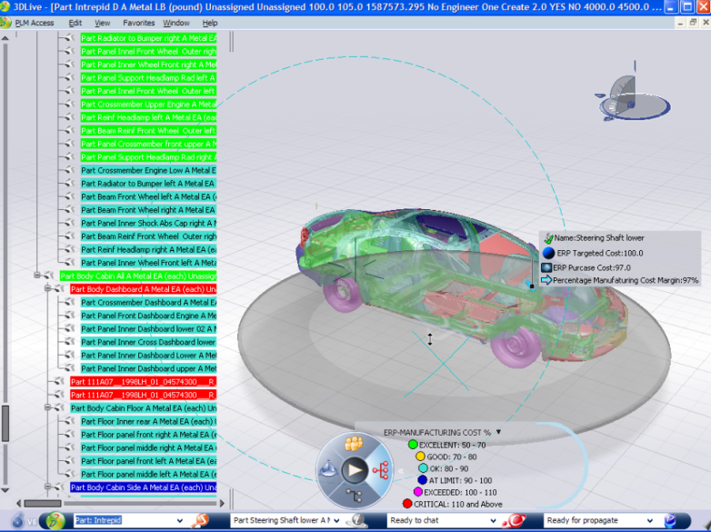
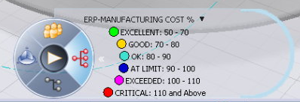
3DLive Dashboarding Use Case
Show me the “Key Performance Indicators” and highlight the CriticalERP-Manufacturing COST
ERP Attributes
HTTP
ENOVIA V6
ERP

Slide 16
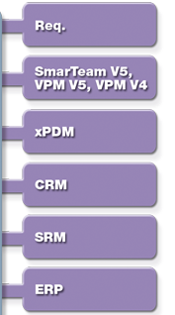
Adaplets: ENOVIA Unique Technology for Federation
Adaplets enable V6 users to access and consume data stored in various enterprise systems (ERP, PDM, etc.) as if these data were in V6
Real time access
Without replicating data in V6
Without modifying data in target system
Extends core V6 PLM data storage management layer to include external heterogeneous data:
Enable modeling virtually any data source as a collection of ENOVIA V6 objects
Data exchange flow is driven by events/business logic in V6 – not by target systems

Slide 17
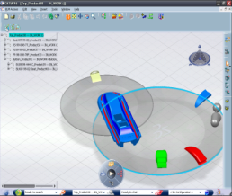

IP Federation Architecture
Enterprise
ENOVIA V6
Data flow is driven by events/business logic in V6 – not by target systems
Adaplets
Each target System requires a dedicated custom adaplet connector :
xPDM
ERP
…

Slide 18





IP Federation Connectors
DS OOTB Connectors
ENOVIA VPM V5
SAP, JDEdwards
Scenarios:
WIP Collaboration,
MBOM integration
ProSTEP
SAP PLM
TeamCenter Engineering
Agile ePLM
Windchill, PDM Link, Pro/INTRALINK
Doors (to be released soon)
Scenarios:
Federated EBOM
Dashboarding with 3DLive
Incremental migration

Slide 19
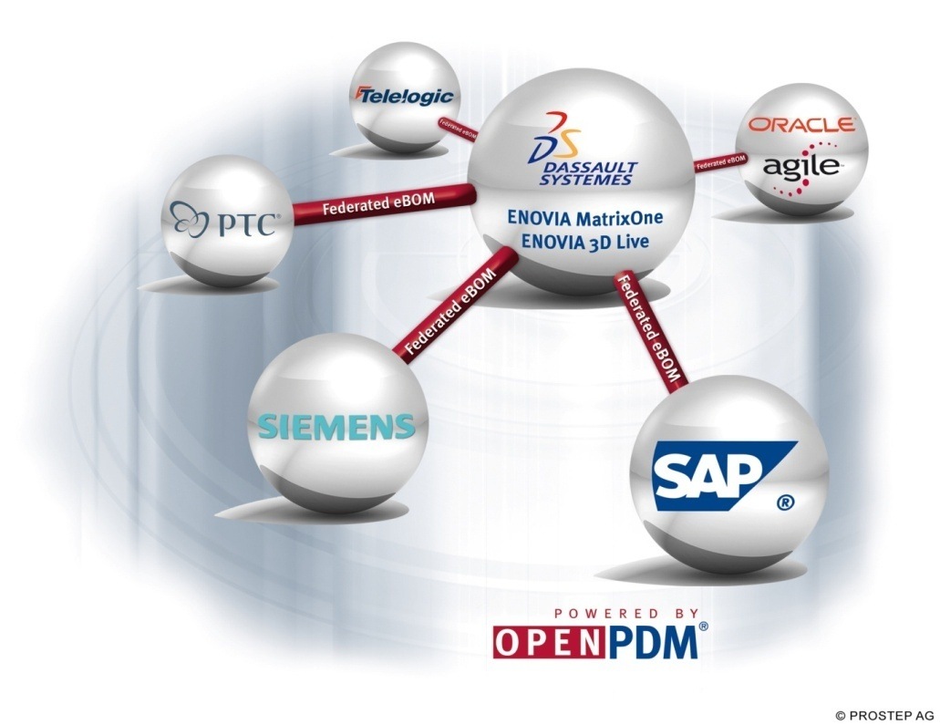

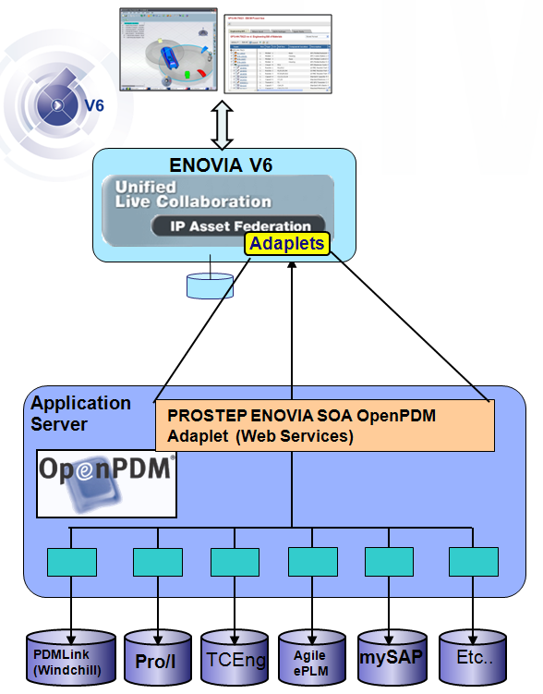

FederatedeBOM
A Solution from DassaultSystèmes and PROSTEP AG
Provides connectivity to external enterprise data
Use external data as though it resided in EM1
Based on EM1 10.7.1 WEB Services and infrastructure
PROSTEP CAA Federated eBOM Connectors

Slide 20
Agenda
3
V6 PLM Integration Strategy
1
1.1
Desktop Applications Integration
1.2
IP Federation
1.3
xPDM orchestration

Slide 21
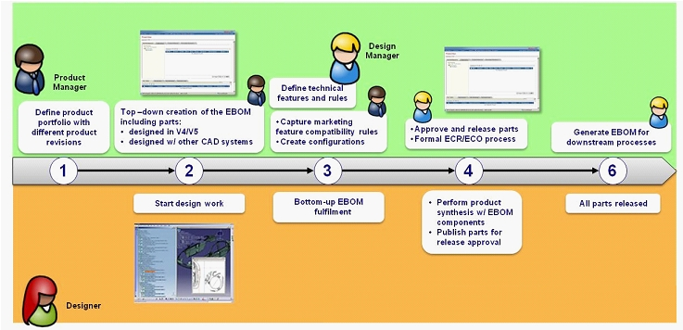
DS OOTB Orchestration Example
ENOVIA X-BOM for VPM V5
Scope
Publish ENOVIA VPM V5 product structure in ENOVIA V6 Engineering Central EBOM
Synchronize/update ENOVIA V6 Engineering Central EBOM and VPM V5 product structure as required by enterprise changes
Manage engineering changes through ECR/ECO process
ENTERPRISE: ENOVIA V6 Business Process
ENGINEERING: CATIA V4/V5 & ENOVIA VPM V5

Slide 22



V6 xPDM Services: Enabling Process Orchestration
The solution providing deployment flexibility and customization capability
V6
xPDM Services
IP Work In Progress and Downstream processes support
X-BOM Synchronization
Configured Product Structure Synchronization
Design-in-Context
Engineering Process Orchestration
Supply Chain Integration
Configuration Mgmt
Change Mgmt
Desktop
Use Cases
Authoring Application Integration
Desktop Application
xPDM Orchestration
IP Federation
V6 xPDM Services
Connectors
connectors

Slide 23

V6 xPDM Services: Deployment Flexibility
Ready to Use
Custom
3 Components are required to integrate V6 w/ other enterprise solutions
OOTB connectors for xPDM systems
Partners Connectors
Your OWN xPDM Connectors
Existing
SOA connection
xPDM connector
DS Connectors
DS Toolkit
Orchestration
DS OOTB Orchestration
DS OOTB Orchestration
V6 xPDM Services
V6 xPDM Services
V6 xPDM Services
V6 xPDM Services
DS OOTB
V6 Connector
DS OOTB
V6 Connector
your OWN SOA connection
V6 Connector
Option 1
Option 2
Option 3
Notes:
This slide shows the great flexibility allowed by the V6 xPDM Services approach.
Customers can choose to implement a complete OOTB solution ( left), develop their own xPDM connector with the DS Toolkit (middle)) and/or leverage an existing implementation (Orchestration Engine / Service Bus and xPDM connectors) and connect it to V6 through the V6 xPDM Services.

Slide 24
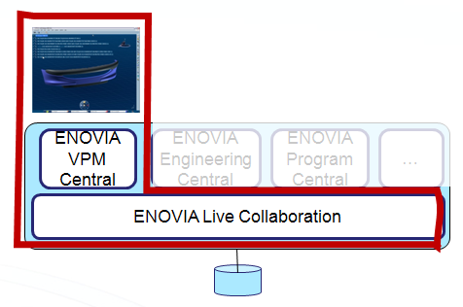
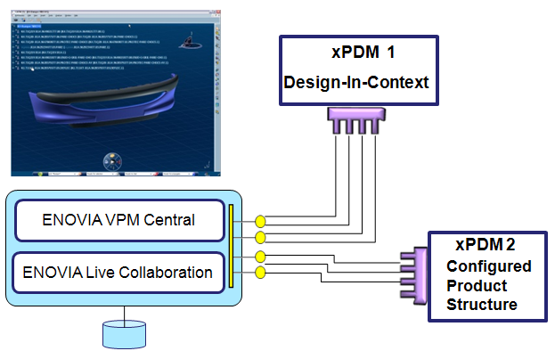
V6 xPDM Services Footprint for CATIA/DELMIA/SIMULIA V6
Only ENOVIA VPM Central is mandatory to leverage V6 xPDM Services for CATIA / DELMIA / SIMULIA V6
ENOVIA VPM Central is delivered by default in all V6 authoring configurations

Slide 25
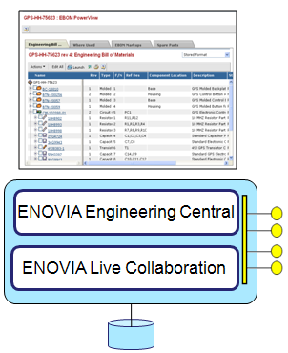
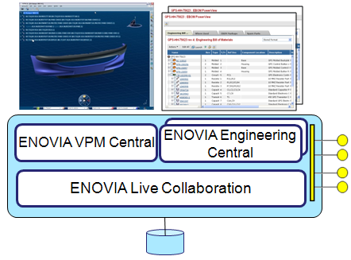
V6 xPDM Services Footprint for Enterprise Users
Customers with different ENOVIA V6 applications can also use V6 xPDM Services to integrate V6 business processes with other xPDM and ERPs
… Only Engineering Central (EBOM)
… Or combined with any Central (Program Mgmt, Sourcing, …)

Slide 26
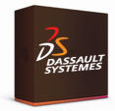

V6 xPDM Services Integration Architecture - OOTB
Deploy Out-of-the-Box Connectors with Predefined Coupling &Orchestration
HTTP
ENOVIA V6
Enterprise
DS Orchestration engine relying on IBM/MS middleware
Customer can use DS or Partners connectors or develop their own with the Tool-kit
Each External system requires a dedicated connector
Connector 1
Connector 2
Connector n
xPDM
ERP
…

Slide 27
V6 xPDM Services Integration Architecture - SOA
Reuse Existing Enterprise ‘Orchestration Engine’ &Develop Your Own Connectors
Loose coupling applications ; Leverage V6 SOA platform
HTTP
ENOVIA V6
Enterprise
Web Services
HTTP/SOAP
Enterprise Orchestration engine
Customer Service Bus
xPDM
ERP
…

Slide 28
Take Away
Desktop Application Integration: Application focus
Immersive, dedicated integrations to 3rd party authoring applications with seamless user experience
IP Federation: Master Data focus
Real-time
Without replicating data in V6
Without modifying data in target system
xPDM Orchestration: Process Focus
Bi-directional
Asynchronous
Partial data are replicated in systems
Replicated data can be alternatively authored in both systems with enforced control
Fully automatic
V6 xPDM Services
For CATIA V6 , DELMIA V6, SIMULIA V6 and ENOVIA V6

Slide 29
THANK YOU !

